Slide 1
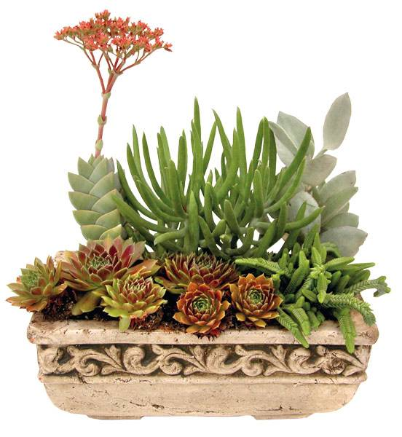

Succulents. And so much more.
January 2010
All information contained is confidential.
© 2010 Altman Plants

